Slide 1

KneeVision
Team S.T.A.R Labs

Slide 2
Agenda
01
02
03
04
05
OUR TEAM
PROJECT DESCRIPTION
TOOLS & TECHNOLOGY
TEAM LOGISTICS
RETROSPECTIVE
Roles and Project Responsibilities
Problem, Personas and Product Idea
Tech Stack and Algorithms
Schedule and Team Agreement
Analysis and Action Items

Slide 3
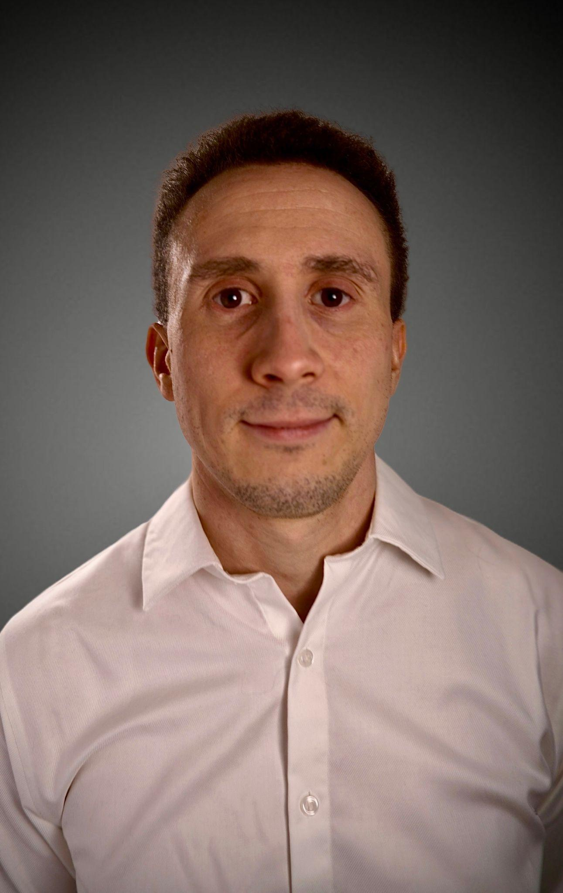

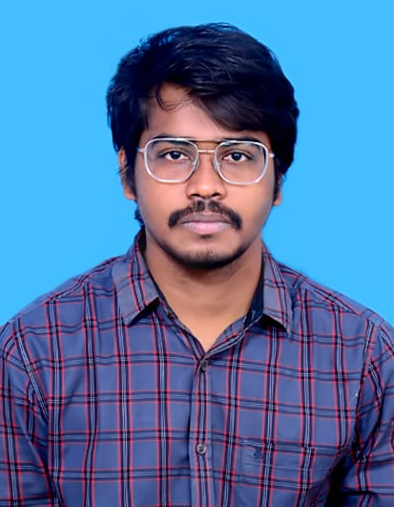
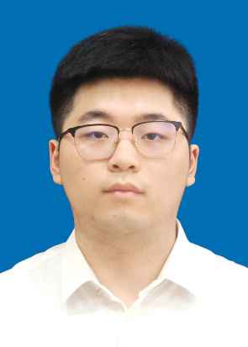
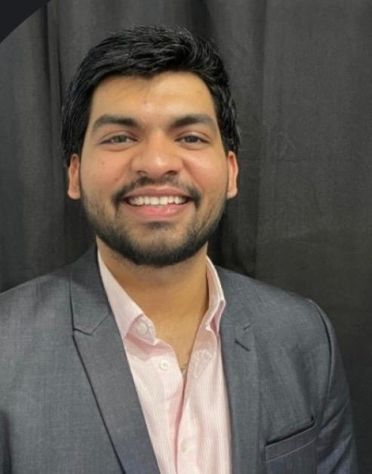

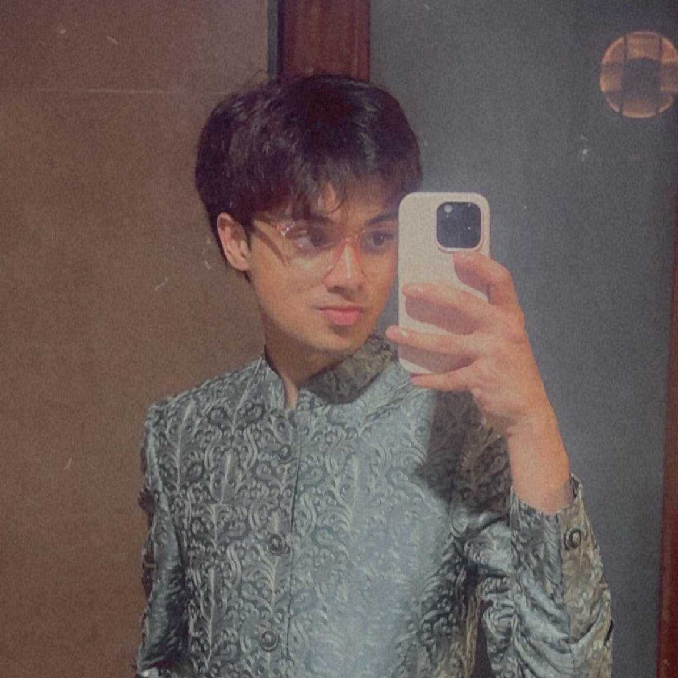
Our Research Team
Daniel Fox
Team Leader/
Developer
Manohar Killamsetti
Scrum Master/Developer
Siming Li
Developer/Tester
Sarvesh Shah
Cloud Developer
Swatej Goud
Backend Developer
Deep Patel
ML Developer

Slide 4
Problem Statement
Knee X-ray imaging is commonly used to evaluate osteoarthritis, yet interpreting radiographic signs of disease severity can be subjective and inconsistent due to subtle visual differences and reliance on manual assessment. While advanced imaging techniques such as MRI provide greater detail, they are expensive and less accessible. This creates a need for scalable and consistent analysis methods that can assist in assessing knee osteoarthritis using widely available X-ray images.

Slide 5
Project Definition
A web-based platform that uses deep learning to analyze knee X-ray images for knee osteoarthritis severity assessment.
Intended for individuals, researchers, and clinicians seeking consistent and scalable analysis of knee X-ray data.
Leverages publicly available datasets and established convolutional neural network (CNN) models.
Designed as an AI-assisted decision-support and research tool, not a diagnostic system.
Benefits include improved consistency, scalability, and reduced subjectivity in manual X-ray interpretation.

Slide 6



Persona - 1: The Practitioner
ORTHOPEDIC SURGEON | URBAN TEACHING HOSPITAL
Dr. Sarah Chen, 42
An expert in orthopedic medicine with 15 years of experience. Sarah operates in high-volume clinics where diagnostic speed is paramount to patient throughput and surgical triage.
KEY GOALS
Rapid knee X-ray triage
Fatigue from patient volume
Reduce initial assessment time
Reader reporting variability
Limited case analysis time
Validation for borderline cases

Slide 7

Persona - 2: The Research Coordinator
CLINICAL RESEARCH COORDINATOR
Alex Rodriguez, 29
A data-centric professional managing multi-site studies. Alex focuses on standardization, data integrity, and inter-rater reliability across large datasets.
STRATEGIC GOALS
•
Standardize severity grading
Efficient batch processing
•
•
Structured data exporting
Ensure rater reliability
OPERATIONAL PAINS
Manual grading inconsistency
Lengthy training cycles
•
•
Audit trail requirements
•
•
Historical data re-analysis

Slide 8

Persona - 3: The Learner
3RD YEAR MEDICAL STUDENT
Maya Patel, 24
A digital native in her clinical rotations. Maya uses the platform as a pedagogical tool to build pattern recognition skills and diagnostic confidence before her residency.
LEARNING GOALS
ACCESS OBSTACLES
•
Identify radiographic signs
•
Limited diverse case access
•
Immediate feedback practice
•
Assessment uncertainty
•
Grade/Clinical correlation
•
Limited attending time

Slide 9
What will our MVP be?
Web-based interface
Image preprocessing pipeline
Deep learning model
Severity assessment output
Basic result visualization
Mobile-responsive UI

Slide 10

















Tools & Technologies
Languages:
Frontend:
Backend:
ML/DL Libraries:
Database:
Cloud:
Tools:
ML Inference:
Misc. Libraries:

Slide 11
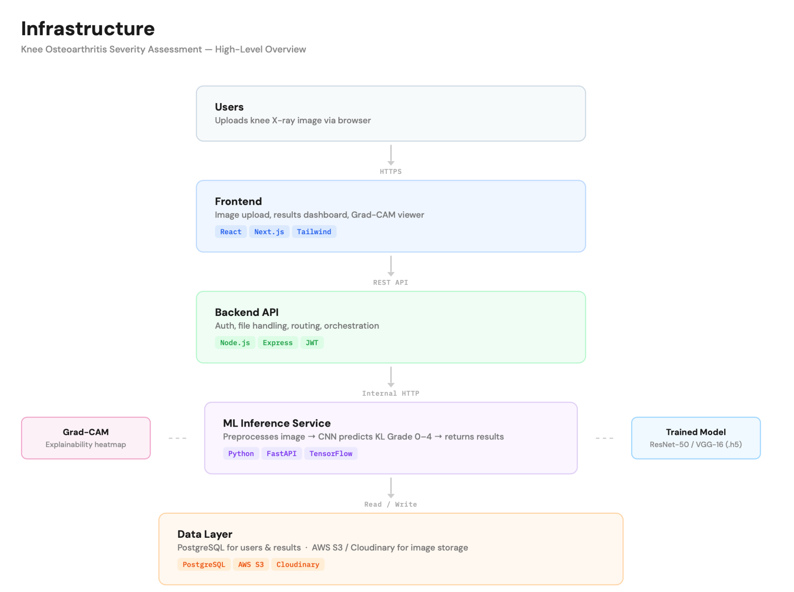
Technical Infrastructure

Slide 12
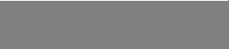
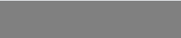
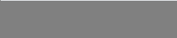
Project Roadmap
Sprint Schedule & Key Deliverable
0
1
2
3
DEADLINE: FEB 19
DEADLINE: MAR 26
DEADLINE: APR 16
DEADLINE: MAY 14
Foundation
Core Features
AI Engine
Deployment
Project Charter & MVP
User Auth
Model Training
History & CSV Export
GitHub & Tech Stack Setup
Image Upload
Prediction API
Security & UAT Audit
Backlog Creation
Image Gallery
KL Grade Results
Production Launch
DELIVERABLES:
DELIVERABLES:
DELIVERABLES:
DELIVERABLES:
Presentation + Wiki + Backlog
Working Demo + Wiki + Tests
AI Demo + Draft Paper + Wiki
Final MVP + Full Documentation

Slide 13
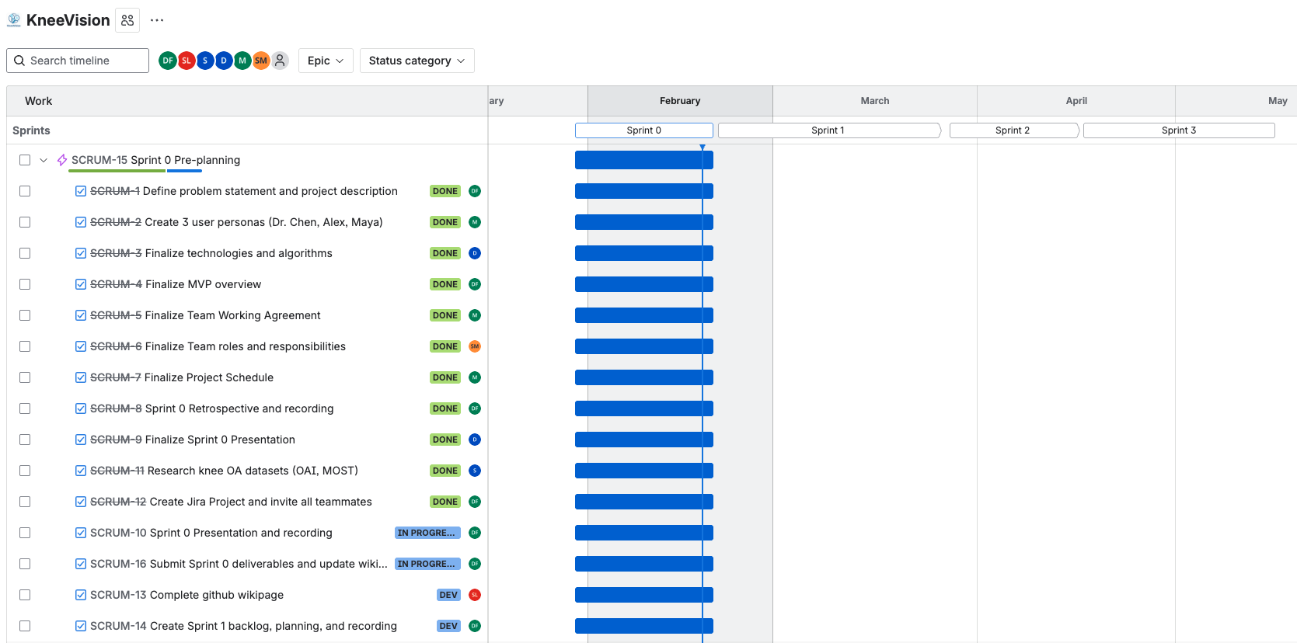
Project Schedule

Slide 14
Team Agreement: Collaboration Standards
Meeting Pattern
Synchronous sessions twice weekly (Sun/Tue). Mandated Agenda
documents for every session.
Continuous async sync via WhatsApp/Discord.
Decision Making
Majority-vote consensus based on researched evidence. Inclusive voicing of concerns during all discussion phases.
Technical Workflow
No direct pushes to Main. Isolated feature branches only.
Peer Approval. Every PR requires at least one secondary reviewer.
Jira Hygiene. Mandatory linking of work to Jira tracker IDs.
Blockers. Resolve locally & document attempts before escalation.

Slide 15
Team Agreement: Definition of “Done”
Category | Standard for Completion
Execution | Code runs without syntactical or runtime errors.
Compliance | Work meets all Industry Standards.
Verification | Work reviewed by multiple members & verified on multiple systems.
Documentation | All necessary docs tagged or updated along with code push.
Testing | All pre-defined test scenarios must be passed.

Slide 16

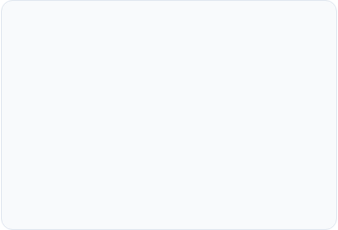
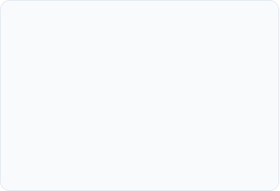



Sprint 0 Retrospective: Important Points
What Went Well
Improvements
Action Items
Strong team engagement and collaboration throughout Sprint 0
Early alignment on a feasible project scope (Knee Osteoarthritis)
Effective communication and idea sharing during planning
Timely completion of Sprint 0 deliverables
Meetings occasionally ran longer than planned
Discussions sometimes lacked clear structure or focus
Varying familiarity with the selected tech stack
MVP scope refinement took longer than expected
Establish a clear agenda for each meeting
Assign a meeting facilitator/timekeeper
Ensure all team members review the tech stack before Sprint 1
Finalize MVP features early to guide development

Slide 17
Wiki Page Link
https://github.com/htmw/STARLABS/wiki#kneevision

Slide 18
THANK YOU
Team S.T.A.R Labs

